Slide 1


Noida Institute of Engineering and Technology, Greater Noida
Software Testing
Unit: IV
Software Engineering
ACSE0603
Dr. Poornima Tyagi
Associate Professor
Department of CS
( B Tech 3rd Year)

Slide 2

Faculty Profile
FACULTY PROFILE
Name of Faculty: Dr. Poornima Tyagi
Designation & Department: Associate Professor , CSE Dept.
Qualification: MCA, MTech & PhD
Experience: Have 12 years experience of teaching subjects such as Modeling & Simulation, Cyber Security, DBMS, Software Engineering, Software Project management.

Slide 3
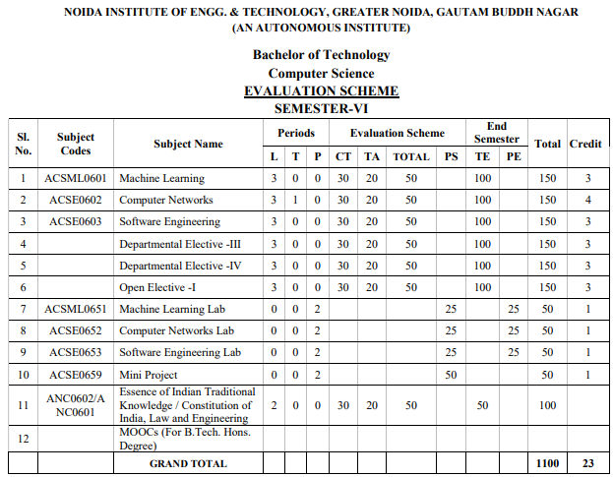
Evaluation Scheme

Slide 4

Syllabus
UNIT-I | Introduction | 8 Hours
Introduction: Evolving role of software, Software Characteristics, Software crisis, Silver bullet, Software myths, Software Engineering Phases, Team Software Process (TSP), emergence of software engineering, Software process, project and product, Software Process Models: Waterfall Model, Prototype Model, Spiral Model, Iterative Model, Incremental Model, Agile Methodology: Scrum Sprint, Scrum Team, Scrum Master, Product Owner.
UNIT-II | Software Requirement | 8 Hours
Software Requirement Specifications (SRS): Requirement Engineering Process: Elicitation, Analysis, Documentation, Review and Management of User Needs, Feasibility Study, Information Modelling, Use Case Diagram, Data Flow Diagrams, Entity Relationship Diagrams, Decision Tables, SRS Document, IEEE Standards for SRS. Software Quality Assurance (SQA): Quality concepts, SQA activities, Formal approaches to SQA; Statistical software quality assurance; CMM, The ISO standard.

Slide 5
Syllabus
UNIT-III | Software Design | 8 Hours
Software Design: Design principles, the design process; Design concepts: refinement, modularity: Cohesion, Coupling, Effective modular design: Functional independence, Design Heuristics for effective modularity, Software architecture: Function Oriented Design, Object Oriented Design: OOPs concepts-Abstraction, object, classification, inheritance, encapsulation, UML Diagrams-Class Diagram, Interaction diagram, Activity Diagram, control hierarchy: Top-Down and Bottom-Up Design, structural partitioning, software procedure.
UNIT-IV | Software Testing | 8 Hours
Software Testing: Testing Objectives, 7 Principals of Testing, Levels of Testing: Unit Testing, System Testing, Integration Testing, User Acceptance Testing, Regression Testing, Testing for Functionality and Testing for Performance, Top Down and Bottom-Up Testing Strategies: Test Drivers and Test Stubs, Structural Testing (White Box Testing), Functional Testing (Black Box Testing), Test Data Suit Preparation, Alpha and Beta Testing of Products. Functional Testing(DAO, BO) Static Testing Strategies: Formal Technical Reviews (Peer Reviews), Walk Through, Code Inspection, Compliance with Design and Coding Standards.

Slide 6

Syllabus
UNIT-V | Project Maintenance And Management Concepts | 8 Hours
Project management concepts, Planning the software project, Estimation: Software Measurement and Metrics, Various Size Oriented Measures-LOC based, FP based, Halestead’s Software Science, Cyclomatic Complexity Measures: Control Flow Graphs, Use-case based, empirical estimation COCOMO- A Heuristic estimation techniques, staffing level estimation, team structures, risk analysis and management. Configuration Management, Software reengineering: reverse engineering, restructuring: forward engineering, Clean Room software engineering. Case Tools, Software Maintenance: Preventive, Corrective and Perfective Maintenance, Cost of Maintenance, Need of Maintenance.

Slide 7
Branch wise Applications
Software engineering applications are new idea, device or process. Innovations are the application of better solutions that meet new requirements, in articulated needs or existing market needs.
The exhaustive and widespread use of computers and the improvements in database technology have provided large data.
The emerging growth of data in databases has generated an urgent need for efficient data mining techniques to discover useful informational knowledge.

Slide 8
Course Objective(unit 4)
To discuss various software testing issues and solutions in software unit test; integration, regression, and system testing.
To expose the advanced software testing topics, such as object-oriented software testing methods, and component-based software testing issues, challenges, and solutions.

Slide 9
Course Outcomes
After completion of this course students will be able to
CO 1 | Identify, formulate, analyse, and solve problems, as well as identify the computing requirements appropriate to their solutions. The ability to work in one or more significant application domains | K2, K4, K5
CO 2 | Design, implement, and evaluate software-based systems, components, or programs of varying complexity that meet desired needs, satisfy realistic constraints, and demonstrate accepted design and development principles. | K2, K3, K4, K6
CO 3 | Apply knowledge of computing, mathematics, science, and engineering appropriate to the discipline, particularly in the modelling and design of software systems and in the analysis of trade-offs inherent in design decisions. | K3, K4
CO 4 | Formulate testing strategies for software system, apply various testing techniques such as unit testing, test driven development and functional testing. | K3
CO 5 | Understand ability to engage in life-long maintenance and continuing Software development using various software management tools. | K2, K5

Slide 10
Program Outcomes (PO)
PO1: Engineering Knowledge
PO2: Problem Analysis
PO3: Design/Development of solutions
PO4: Conduct Investigations of complex problems
PO5: Modern tool usage
PO6: The engineer and society
PO7: Environment and sustainability
PO8: Ethics
PO9: Individual and team work
PO10: Communication
PO11: Project management and finance
PO12: Life-long learning

Slide 11
COs-POs Mapping
CO-PO Correlation Matrices
Correlation levels are taken 1, 2 and 3 as defined below:
1: Slight (Low) 2: Moderate (Medium) 3: Substantial (High)
Software Engineering (Code: ACSE0603) |  |  |  |  |  |  |  |  | Year of Study: 2022-23
CO | PO1 | PO2 | PO3 | PO4 | PO5 | PO6 | PO7 | PO8 | PO9 | PO10 | PO11 | PO12
C01 | 2 | 3 | 3 | 3 | 2 | - | - | - | - | - | 3 | 3
C02 | 3 | 3 | 3 | 3 | 3 | - | - | - | - | - | 2 | 3
C03 | 3 | 2 | 3 | 2 | 2 | - | - | - | - | - | 3 | 3
C04 | 2 | 2 | 2 | 2 | 3 | 3 | - | 3 | 3 | - | 3 | 3
C05 | 2 | 2 | 3 | 2 | 3 | 3 | - | 3 | - | 3 | 3 | 3

Slide 12
Program Specific Outcomes (PSO)
PSO1: Work as a software developer, database administrator, tester or networking engineer for providing solutions to the real world and industrial problems
PSO2:Apply core subjects of information technology related to data structure and algorithm, software engineering, web technology, operating system, database and networking to solve complex IT problems.
PSO 3:Practice multi-disciplinary and modern computing techniques by lifelong learning to establish innovative career.
PSO 4:Work in a team or individual to manage projects with ethical concern to be a successful employee or employer in IT industry

Slide 13
COs-PSOs Mapping
Program Specific Outcomes and Course Outcomes Mapping
CO | PSO1 | PSO2 | PSO3 | PSO4
CO1 | 3 | 3 | - | 3
CO2 | 3 | 3 | 2 | 3
CO3 | 3 | 3 | - | 3
CO4 | 3 | 3 | - | 3
CO5 | 3 | 3 | - | 3
*3= High *2= Medium *1=Low

Slide 14
Program Educational Objectives
PEO1: To have an excellent scientific and engineering breadth so as to comprehend, analyze, design and provide sustainable solutions for real-life problems using state-of-the-art technologies.
PEO2:To have a successful career in industries, to pursue higher studies or to support entrepreneurial endeavors and to face global challenges.
PEO3:To have an effective communication skills, professional attitude, ethical values and a desire to learn specific knowledge in emerging trends, technologies for research, innovation and product development and contribution to society.
PEO4: To have life-long learning for up-skilling and re-skilling for successful professional career as engineer, scientist, entrepreneur and bureaucrat for betterment of society

Slide 15
Program Educational Objectives
Program Educational Objective and Course Outcomes Mapping
CO | PEO1 | PEO2 | PEO3 | PEO4
CO1 | 3 | 3 | - | 1
CO2 | 3 | 3 | - | 3
CO3 | 3 | 3 | - | 3
CO4 | 3 | - | - | -
CO5 | 3 | 3 | - | 3
*3= High *2= Medium *1=Low

Slide 16
Result Analysis
Subject Result: NA
Department Result: NA
Faculty-Wise Result: NA

Slide 17
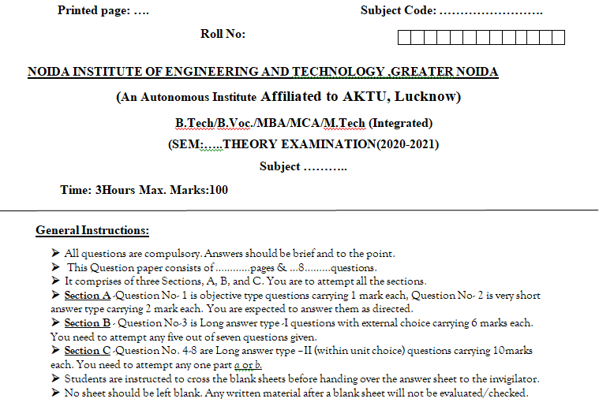
End Semester Question Paper Template

Slide 18
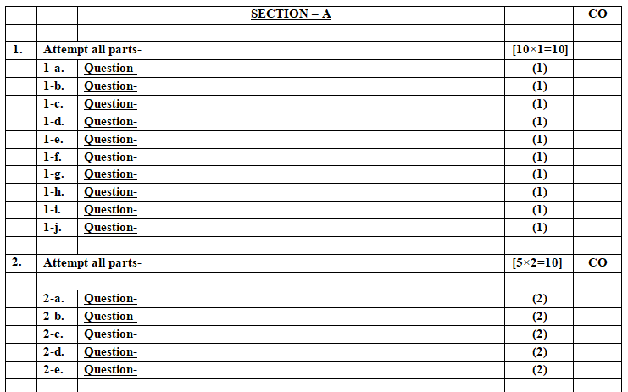
End Semester Question Paper Templates

Slide 19
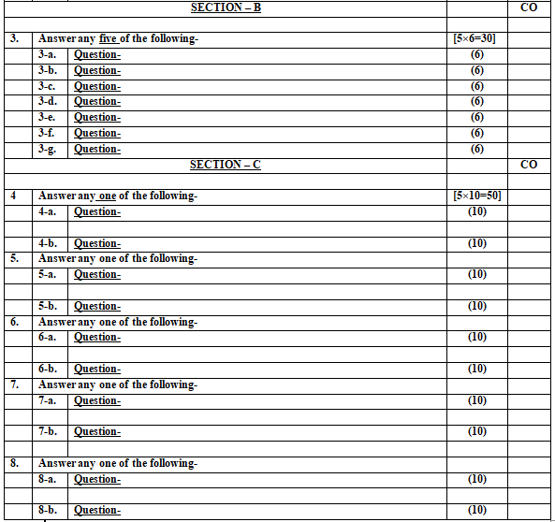
End Semester Question Paper Templates

Slide 20
Prerequisite
A Scripting Language
A Version Control Tool
Code Editors & IDEs (Integrated Development Environment)
Databases
Networking
Software Development Life Cycle (SDLC)

Slide 21
Recap
Basic Programming Skills
Innovative Thinking.
Enthusiasm to learn Management concepts.

Slide 22
Brief Introduction about the subject with videos
Software Engineering is a systematic, disciplined, quantifiable study and approach to the design, development, operation, and maintenance of a software system.
Objectives of Software Engineering:
Maintainability – It should be feasible for the software to evolve to meet changing requirements.
Efficiency – The software should not make wasteful use of computing devices such as memory, processor cycles, etc.
Correctness – A software product is correct if the different requirements as specified in the SRS document have been correctly implemented.
https://www.youtube.com/watch?v=kcvEiMFOcoE
https://www.youtube.com/watch?v=WxkP5KR_Emk

Slide 23
Unit Content
Software Testing: Testing Objectives, 7 Principals of Testing, Levels of Testing: Unit Testing, System Testing, Integration Testing, User Acceptance Testing, Regression Testing, Testing for Functionality
Top Down and Bottom-Up Testing Strategies: Test Drivers and Test Stubs, Structural Testing (White Box Testing), Functional Testing (Black Box Testing), Test Data Suit Preparation, Alpha and Beta Testing of Products.
Functional Testing(DAO, BO) Static Testing Strategies: Formal Technical Reviews (Peer Reviews), Walk Through, Code Inspection, Compliance with Design and Coding Standards.

Slide 24
Objective of Topics
TOPIC | Objective
Unit Testing, Integration Testing | To Understand the need of testing and process of unit and integration testing
Testing for Functionality | Study of testing functionalities
Testing for Performance | To measure the performance of testing
Structural Testing and Functional Testing | To understand the white box and black box testing
Test Data Suit Preparation, Alpha and Beta testing | To study the alpha and beta testing
Static Testing Strategies | To study the Formal Technical Reviews, Walk Through, Code Inspection, Compliance with Design

Slide 25
Software Testing (CO4)
Testing is a set of activities that can be planned in advance and conducted systematically. For this reason a template for software testing- a set of steps into which we can place specific test case design techniques and testing method should be defined for the software process.
Testing have the following generic characteristics.
To perform effective testing, a software team should conduct effective formal technical reviews. By doing this many errors will be eliminated before testing commence.

Slide 26
Objective of Testing
The aim of program testing is to help realise, identify all defects in a program.
The testing objective is to test the code whereby there is a high probability of discovering all errors.
This objective also demonstrates that the software functions are working according to software requirements specifications (SRS) with regard to functionality, features, facilities and performance.
Testing objectives are
Testing is a process of executing a program with the intent of finding an error.
A good test case is one that has a high probability of finding an as yet undiscovered error

Slide 27
Some Terminologies
• Programming is human effort-intensive:
– Therefore, inherently error prone.
• IEEE std 1044, 1993 defined errors and faults as synonyms :
• IEEE Revision of std 1044 in 2010 introduced finer distinctions:
– To support more expressive communications, it distinguished between Errors and Faults

Slide 28
Some Terminologies
Mistake: A mistake is essentially any programmer action that later shows up as an incorrect result during program execution.
Ex: not initializing a certain variable, division by zero
Error: An error arises during the development phase. It occurs when the development team misunderstands a requirement, leading to buggy code.
Example: If a developer misinterprets a specification and writes code that doesn’t handle edge cases properly, it results in an error
Fault: A fault occurs due to various factors, such as lack of resources or not following proper steps during software development. It represents unintended behavior by the application.
Example: Let’s say a programmer forgets to initialize a critical variable, causing unexpected behavior in the software. This situation is a fault
A failure occurs when a fault executes. A particular fault may cause different failures, depending on how it has been exercised.

Slide 29
Some Terminologies
Bug: A bug refers to a defect or flaw in a software product or application. It means that the software is not functioning as per the specified requirements.
Example: Imagine a web application where the “Login” button fails to work. Users cannot log in, preventing the website from functioning as intended. This situation is a bug
Defect: A defect also signifies an issue in the software. It occurs when the application does not align with the expected results or requirements.
Example: Suppose an e-commerce application calculates shipping costs incorrectly, resulting in overcharging customers. This discrepancy between expected and actual behavior constitutes a defect

Slide 30

Some Terminologies
Fault, defect, or bug
Failure
Error or mistake
Specification
Design
Code

Slide 31


A Few Error Facts
• Even experienced programmers make many errors:
– Avg. 50 bugs per 1000 lines of source code
• Extensively tested software contains:
– About 1 bug per 1000 lines of source code.
• Bug distribution:
– 60% spec/design, 40% implementation.
Bug Source
Spec and Design
Code

Slide 32
How to Reduce Bugs?
• Review
• Testing
• Formal specification and verification
• Use of development process

Slide 33
How to Test?
Check if the program behaved as expected.
• Input test data to the program.
• Observe the output:

Slide 34
Testing Facts
• Consumes the largest effort among all development activities:
– Largest manpower among all roles
– Implies more job opportunities
• About 50% development effort
– But 10% of development time?
– How?
Testing is getting more complex and sophisticated every year.
– Larger and more complex programs
– Newer programming paradigms
– Newer testing techniques
– Test automation

Slide 35
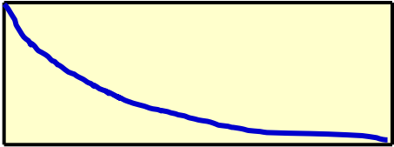
Test How Long?
One way:
# Bugs
Time
• Another way:
– Seed bugs… run test cases
– See if all (or most) are getting detected

Slide 36
Test, Test Case and Test Suite (CO4)
Test case
A test case is a triplet [I , S, R], where I is the data input to the program under test, S is the state of the program at which the data is to be input, and R is the result expected to be produced by the program. Ex. The text editor can at any time during its execution assume any of the following execution modes—edit, view, create, and display.
A test case is said to be a positive test case if it is designed to test whether the software correctly performs a required functionality.
It is said to be negative test case, if it is designed to test whether the software carries out something, that is not required of the system.
Test Suite: A test suite is the set of all test that have been designed by a tester to test a given program.
Testability: the testability of a requirement is the degree to which an implementation of it can be adequately tested to determine its conformance to the requirement.

Slide 37
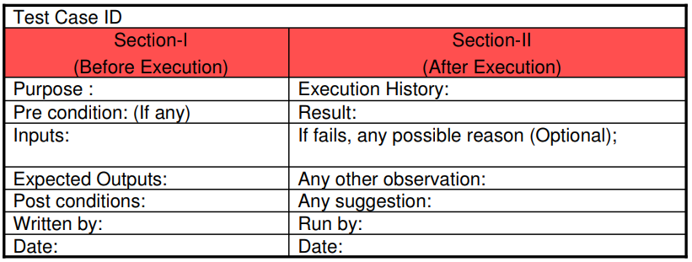
Test, Test Case and Test Suite (CO4)
Test scenario:
A test scenario is an abstract test case in the sense that it only identifies the aspects of the program that are to be tested without identifying the input, state, or output. A
In the test case, the input, output, and the state at which the input would be applied is designed such that the scenario can be executed.

Slide 38
CASE STUDY
Test Scenario: Verify that users can successfully place an order for items in their shopping cart.
Objective: The objective of this test scenario is to ensure that the checkout process of the e-commerce website functions correctly and allows users to purchase items from their shopping cart without encountering errors.
Preconditions:
The user is logged into their account.
The user has added one or more items to their shopping cart.
Inputs:
The user clicks on the "Checkout" button.
Actions:
The system displays the checkout page, where the user can review their order details, shipping information, and payment method.
The user fills in the required shipping information, such as name, address, and contact details.
The user selects a payment method (e.g., credit card, PayPal).
The user confirms the order by clicking on the "Place Order" button.
Expected Results:
The system processes the order without errors.
The user receives an order confirmation message.
The user's shopping cart is updated to reflect the purchased items being removed.
The user can view the order details in their account's order history.
The user receives an email confirmation with the order details.
Postconditions:
The user's order is successfully placed and processed.
The user can track the status of their order through the order tracking system.
The user's account reflects the recent order in their order history.

Slide 39
Verification and Validation
Verification: Software should confirm to its.(are we building the product right?)
It is the process of determining whether the output of one phase of software development conforms to that of its previous phase. Thus verification is concerned with phase containment of errors
Validation: Software should do what the user really require.(are we building the right product?)
It is the process of determining whether a fully developed system conforms to its requirements specification. the aim of validation is that the final product be error free.
Testing= Verification + Validation

Slide 40
Verification and Validation
• Verification is the process of determining:
–Whether output of one phase of development conforms to its previous phase.
• Validation is the process of determining:
–Whether a fully developed system conforms to its SRS document..
• Verification is concerned with phase containment of errors:
–Whereas, the aim of validation is that the final product is error free.
48

Slide 41
Verification and Validation
Verification and Validation Techniques
• System testing
• Review
• Simulation
• Unit testing
• Integration testing

Slide 42
Verification and Validation
Verification | Validation
Are you building it right? | Have you built the right thing?
Checks whether an artifact conforms to its previous artifact. | Checks the final product against the specification.
Done by developers. | Done by Testers.
Static and dynamic activities: reviews, unit testing. | Dynamic activities: Execute software and check against requirements.

Slide 43
Software Testing Principles
Principle 1. Testing shows presence of defects
Hence, testing principle states that – Testing talks about the presence of defects and don’t talk about the absence of defects. i.e. Software Testing reduces the probability of undiscovered defects remaining in the software but even if no defects are found, it is not a proof of correctness.
Principle 2. Exhaustive testing is not possible
It is impractical to test every possible input and scenario due to the infinite number of combinations.Exhaustive testing is not possible. Instead, we need the optimal amount of testing based on the risk assessment of the application.
Principle 3. Early testing
Early Testing – Testing should start as early as possible in the Software Development Life Cycle. So that any defects in the requirements or design phase are captured in early stages. It is much cheaper to fix a Defect in the early stages of testing.

Slide 44
Software Testing Principles
Principle 4. Defect clustering
Defect Clustering which states that a small number of modules contain most of the defects detected. This is the application of the Pareto Principle to software testing: approximately 80% of the problems are found in 20% of the modules.
Principle 5. Pesticide paradox
Repetitive use of the same pesticide mix to eradicate insects during farming will over time lead to the insects developing resistance to the pesticide Thereby ineffective of pesticides on insects. The same applies to software testing. Testers cannot simply depend on existing test techniques. He must look out continually to improve the existing methods to make testing more effective.

Slide 45
Software Testing Principles
Principle 6. Testing is context dependent
Testing is context dependent which basically means that the way you test an e-commerce site will be different from the way you test a commercial off the shelf application. All the developed software’s are not identical. You might use a different approach, methodologies, techniques, and types of testing depending upon the application type. For instance testing, any POS system at a retail store will be different than testing an ATM machine.
Principle 7. Absence of errors fallacy
It is possible that software which is 99% bug-free is still unusable. This can be the case if the system is tested thoroughly for the wrong requirement. Software testing is not mere finding defects, but also to check that software addresses the business needs. The absence of Error is a Fallacy i.e. Finding and fixing defects does not help if the system build is unusable and does not fulfill the user’s needs & requirements.

Slide 46
Testing Levels
4 Testing Levels
• Software tested at 4 levels:
–Unit testing
–Integration testing
–System testing
–Acceptance testing

Slide 47
Levels of Testing
Unit testing
– Test each module (unit, or component) independently
– Mostly done by developers of the modules
• Integration and system testing
– Test the system as a whole
– Often done by separate testing or QA team
• Acceptance testing
– Validation of system functions by the customer

Slide 48


Levels of Testing
System Testing
What users really need
Acceptance testing
System testing
Requirements
Integration testing
Integration testing
Design
Unit testing
Unit testing
Code
Maintenance
Regression Testing

Slide 49
Overview of Activities During System and Integration Testing
• Test Suite Design
• Run test cases
• Check results to detect failures.
• Prepare failure list
Tester
• Debug to locate errors
• Correct errors.
Developer

Slide 50
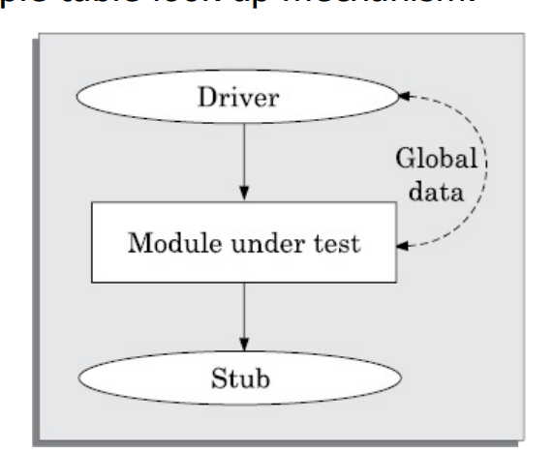
Unit testing
–During unit testing, functions (or modules) are tested in isolation:
Before carrying out unit testing, the unit test cases have to be designed and the test environment for the unit under test has to be developed.

Slide 51
In this context, stubs and drivers are designed to provide the complete environment for a module so that testing can be carried out.
Stub: A stub procedure is a dummy procedure that has the same I/O parameters as the function called by the unit under test but has a highly simplified.
Driver: A driver module should contain the non-local data structures accessed by the module under test. Additionally, it should also have the code to call the different functions of the unit under test with appropriate parameter values for testing.

Slide 52
Integration Testing
The usual software project consists of numerous software modules, many of them built by different programmers. Integration testing shows the team how well these disparate elements work together.
After modules of a system have been coded and unit tested:
–Modules are integrated in steps according to an integration plan
–The partially integrated system is tested at each integration step.

Slide 53
Specific reasons why developers should perform integration testing.
Incompatibility between software modules can cause errors
Developers must confirm that every software module can interact with the database
Requirements change, dueto client input. maybe those new requirements haven't been thoroughly tested yet and should be
Every software developer has their understanding and programming logic. Integration testing ensures that these various units function smoothly
There may be potential problems with hardware compatibility
Modules often interact with third-party APIs or tools, so we need integration testing to verify that the data these tools accept is correct

Slide 54
System Testing
System testing during development involves integrating components to create a version of the system and then testing the integrated system.
The focus in system testing is testing the interactions between components. System testing checks that components are compatible, interact correctly and transfer the right data at the right time across their interfaces.
System testing tests the emergent behavior of a system.
During system testing, reusable components that have been separately developed and off-the-shelf systems may be integrated with newly developed components. The complete system is then tested.
Components developed by different team members or sub-teams may be integrated at this stage. System testing is a collective rather than an individual process.
The use cases developed to identify system interactions can be used as a basis for system testing. Each use case usually involves several system components so testing the use case forces these interactions to occur. The sequence diagrams associated with the use case document the components and their interactions that are being tested.
Smoke test:
– System test performed daily or several times a week after every build.

Slide 55
Functional Testing: This type of testing verifies that the system functions according to the specified requirements. It involves testing each functionality of the system to ensure that it behaves as expected.
Integration Testing: Integration testing checks the interaction between different modules or components of the system. It ensures that the integrated components work together as expected and that data flows correctly between them.
Acceptance Testing: Acceptance testing, also known as user acceptance testing (UAT), is performed to validate whether the system meets the acceptance criteria set by the stakeholders. It involves testing the system in a real-world scenario to ensure it meets user expectations.
Regression Testing: Regression testing ensures that new changes or updates to the system have not adversely affected existing functionalities. It involves re-testing the previously tested features to detect any regressions or unintended side effects.
Performance Testing: Performance testing evaluates the system's performance under various conditions such as load, stress, and scalability. It helps identify performance bottlenecks and ensures that the system can handle the expected workload.

Slide 56
Security Testing: Security testing assesses the system's ability to protect data and resources from unauthorizedaccess, vulnerabilities, and attacks. It includes testing for authentication, authorization, encryption, and other security measures.
Usability Testing: Usability testing evaluates the user-friendliness of the system and determines how easy it is for users to navigate and interact with the system. It focuses on aspects such as user interface design, accessibility, and user experience.
Compatibility Testing: Compatibility testing ensures that the system functions correctly across different platforms, devices, browsers, and operating systems. It verifies compatibility with hardware, software, network environments, and configurations.
Installation Testing: Installation testing verifies that the system can be installed, configured, and deployed correctly in various environments. It includes testing installation procedures, upgrade paths, and compatibility with other software.
Localization and Internationalization Testing: Localization testing checks whether the system supports multiple languages, cultures, and regions, while internationalization testing ensures that the system is designed to be easily localized for different markets.

Slide 57
Types of System Testing
• Based on types test:
– Functionality test
– Performance test
• Based on who performs testing:
– Alpha
– Beta
– Acceptance test

Slide 58
Performance test
• Determines whether a system or subsystem meets its non-functional requirements:
• Response times
• Throughput
• Usability
• Stress
• Recovery
• Configuration, etc.
62

Slide 59
User Acceptance Testing
• User determines whether the system fulfills his requirements
– Accepts or rejects delivered system based on the test results.

Slide 60
Who Tests Software?
• Programmers:
– Unit testing
– Test their own or other’s programmer’s code
• Users:
– Usability and acceptance testing
– Volunteers are frequently used to test beta versions
• Test team:
– All types of testing except unit and acceptance
– Develop test plans and strategy
64

Slide 61

















V&V
Feasibility Study
Req. Analysis
Design
Testing by developers
Coding
Testing by Tester
Review, Simulation, etc.
Testing
Maintenance

Slide 62
Test Cases
• Each test case typically tries to establish correct working of some functionality:
– Executes (covers) some program elements.
– For certain restricted types of faults, fault-based testing can be used.

Slide 63
Test data versus test cases
• Test data:
– Inputs used to test the system
• Test cases:
– Inputs to test the system,
– State of the software, and
– The predicted outputs from the inputs

Slide 64
Test Cases and Test Suites
• A test case is a triplet [I,S,O]
–I is the data to be input to the system,
–S is the state of the system at which the data will be input,
–O is the expected output of the system.
• Test a software using a set of carefully designed test cases:
–The set of all test cases is called the test suite.

Slide 65
What are Negative Test Cases?
• Purpose:
– Helps to ensure that the application gracefully handles invalid and unexpected user inputs and the application does not crash.
• Example:
– If user types letter in a numeric field, it should not crash but politely display the message: “incorrect data type, please enter a number…”

Slide 66
Test Execution Example: Return Book
Test case [I,S,O]
1. Set the program in the required state: Book record created, member record created, Book issued
2. Give the defined input: Select renew book option and request renew for a further 2 week period.
3. Observe the output:
Compare it to the expected output.

Slide 67
Test Team- Human Resources
• Test Planning: Experienced people
• Test scenario and test case design: Experienced and test qualified people
• Test execution: semi-experienced to inexperienced
• Test result analysis: experienced people
• Test tool support: experienced people
• May include external people:
– Users
– Industry experts
79

Slide 68
Why Design of Test Cases?
• Exhaustive testing of any non-trivial system is impractical: –Input data domain is extremely large.
• Design an optimal test suite, meaning: –Of reasonable size, and
–Uncovers as many errors as possible.

Slide 69
Design of Test Cases
• If test cases are selected randomly:
–Many test cases would not contribute to the significance of the test suite,
–Would only detect errors that are already detected by other test cases in the suite.
• Therefore, the number of test cases in a randomly selected test suite:
–Does not indicate the effectiveness of testing
• Testing a system using a large number of randomly selected test cases:
–Does not mean that most errors in the system will be uncovered.

Slide 70
Example
Find the maximum of two integers x and y.
• The code has a simple programming error:
• If (x>y) max = x;
else max = x; // should be max=y;
• Test suite {(x=3,y=2);(x=2,y=3)} can detect the bug,
• A larger test suite {(x=3,y=2);(x=4,y=3); (x=5,y=1)} does not detect the bug.

Slide 71
Test Plan
• Before testing activities start, a test plan is developed.
• The test plan documents the following:
– Features to be tested
– Features not to be tested
– Test strategy
– Test suspension criteria
– stopping criteria
– Test effort
– Test schedule

Slide 72
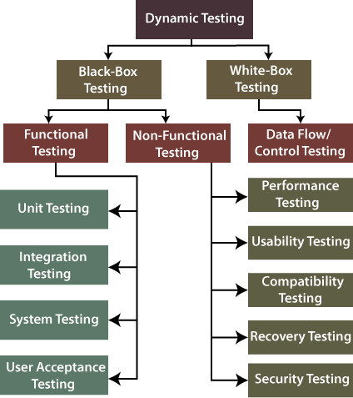

Slide 73
White-box Testing
The word white box is used to describe the core perspective of the system. The developers will perform the white box testing, where they will test every line of the program's code.
When the developers perform the White-box testing and then send the software application to the testing team, the testing team will do the black box testing, validate the application as well as the requirements. The white-box testing is further divided into data flow/control testing.
To design test cases:
–Knowledge of internal structure of software necessary.
–White-box testing is also called structural testing.
18

Slide 74
White-box Testing
The word white box is used to describe the core perspective of the system. The developers will perform the white box testing, where they will test every line of the program's code.
When the developers perform the White-box testing and then send the software application to the testing team, the testing team will do the black box testing, validate the application as well as the requirements. The white-box testing is further divided into data flow/control testing.
To design test cases:
–Knowledge of internal structure of software necessary.
–White-box testing is also called structural testing.
18

Slide 75
White-box Testing
Generic steps of white box testing
Design all test scenarios, test cases and prioritize them according to high priority number.
This step involves the study of code at runtime to examine the resource utilization, not accessed areas of the code, time taken by various methods and operations and so on.
In this step testing of internal subroutines takes place. Internal subroutines such as nonpublic methods, interfaces are able to handle all types of data appropriately or not.
This step focuses on testing of control statements like loops and conditional statements to check the efficiency and accuracy for different data inputs.
In the last step white box testing includes security testing to check all possible security loopholes by looking at how the code handles security.

Slide 76
White-box Testing
Reasons for white box testing
It identifies internal security holes.
To check the way of input inside the code.
Check the functionality of conditional loops.
To test function, object, and statement at an individual level.

Slide 77
White-box Testing
Advantages of White box testing
White box testing optimizes code so hidden errors can be identified.
Test cases of white box testing can be easily automated.
This testing is more thorough than other testing approaches as it covers all code paths.
It can be started in the SDLC phase even without GUI.
Disadvantages of White box testing
White box testing is too much time consuming when it comes to large-scale programming applications.
White box testing is much expensive and complex.
It can lead to production error because it is not detailed by the developers.
White box testing needs professional programmers who have a detailed knowledge and understanding of programming language and implementation.

Slide 78
Techniques of White-box Testing- Data Flow Testing
Data Flow Testing
Data flow testing is a group of testing strategies that examines the data flow of programs in order to explore the sequence of variables according to the sequence of events (focuses on how data is transmitted and processed within the program).
Ex: Imagine you have a bank app where you can transfer money from one account to another.
Input Data:
You type in the account numbers and how much money you want to transfer.
Data Processing:
The app checks if you have enough money in your account.
If you do, it takes the money from your account and puts it in the other account.
Output Data:
You see a message saying the transfer was successful.

Slide 79
Techniques of White-box Testing- Data Flow Testing
Data Flow Testing checks if this whole process works smoothly:
Find the Path:
We look at how data (like your account numbers and transfer amount) moves through the app.
Test Different Situations:
We try different scenarios:
What happens if you have enough money?
What if you don't?
What if you type in the wrong account number?
Check Everything:
We make sure the app handles these situations correctly.
For example, it should show an error if you don't have enough money.
Make Sure Nothing's Missed:
We make sure we've tested all the different ways data can move through the app.

Slide 80
Techniques of White-box Testing- Control Flow Testing
Control flow testing determines the execution order of statements or instructions of the program through a control structure. The control structure of a program is used to develop a test case for the program. In this technique, a particular part of a large program is selected by the tester to set the testing path. Test cases represented by the control graph of the program.
The control flow testing process involves the following steps,
1. Control Flow Graph Creation
Start by creating a control flow graph, a visual representation of how the program runs based on the source code. It can be created manually or with a software.
2. Coverage Target
A coverage target is defined over the CFG, which includes nodes, paths, edges, branches, etc. Here, testers will decide what part of the graph has to be tested.
3. Test Case Creation
Develop specific test scenarios and test cases based on the control flow graph to cover the designed coverage target.
4. Test Case Execution
Now, execute the test cases that were created to target specific parts of the program.
5. Analysis
Analyze the test results and find out if the program behaves as expected or not.

Slide 81
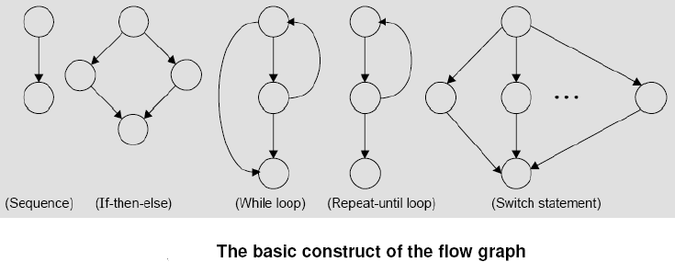
Cyclomatic Complexity Measure (CO3)
Control Flow Graph
The control flow of a program can be analyzed using a graphical representation known as control flow graph.
The flow graph is a directed graph in which nodes are either entire statements or fragments of a statement, and edges represents flow of control

Slide 82
Techniques of White-box Testing- Control Flow Testing
Notations used
Nodes
Decision node
The last node
Edge
Advantages
It identifies nearly half of the defects found during unit testing.
Control flow testing can be performed manually or using test automation platforms.
It helps detect at least one-third of the defects of the overall program. Thus, it increases the efficiency of testing.
It helps test every edge and node in a program, thereby helping achieve high test coverage.

Slide 83
Disadvantages
Though it offers advantages, it has other drawbacks as follows,
Identifying missing paths in a large control flow graph can be challenging, mainly when one person handles the program and its model.
Control flow testing may not detect all errors during the variable’s instantiation.
The errors identified during specification may not always be detected during testing.
Detecting mistakes or discrepancies in the interface is particularly difficult during testing.

Slide 84
Cyclomatic Complexity
It is a software metric to indicate the complexity of software program. The cyclomatic complexity of a code section is the quantitative measure of the number of linearly independent paths in it. The cyclomatic complexity of a code section is the quantitative measure of the number of linearly independent paths in it. For example, if the source code contains no control flow statement then its cyclomatic complexity will be 1, and the source code contains a single path in it.

Slide 85
M = E – N + 2P
where E = the number of edges in the control flow graph N = the number of nodes in the control flow graph P = the number of connected components
In case, when exit point is directly connected back to the entry point. Then complexity is
M = E – N + P
where
E = the number of edges in the control flow graph N = the number of nodes in the control flow graph P = the number of connected components

Slide 86
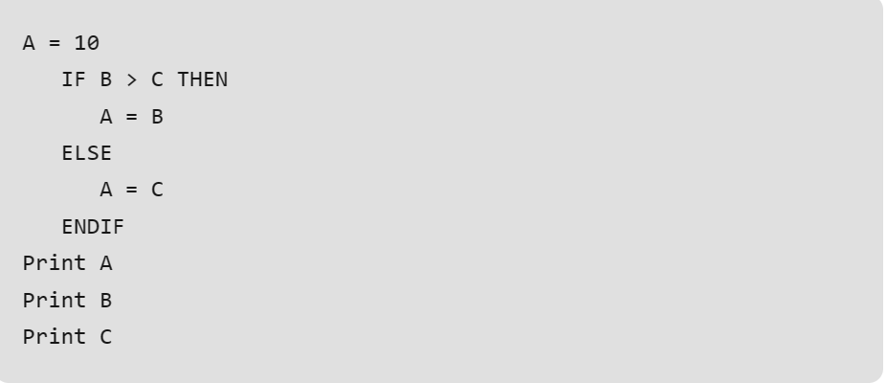

Slide 87
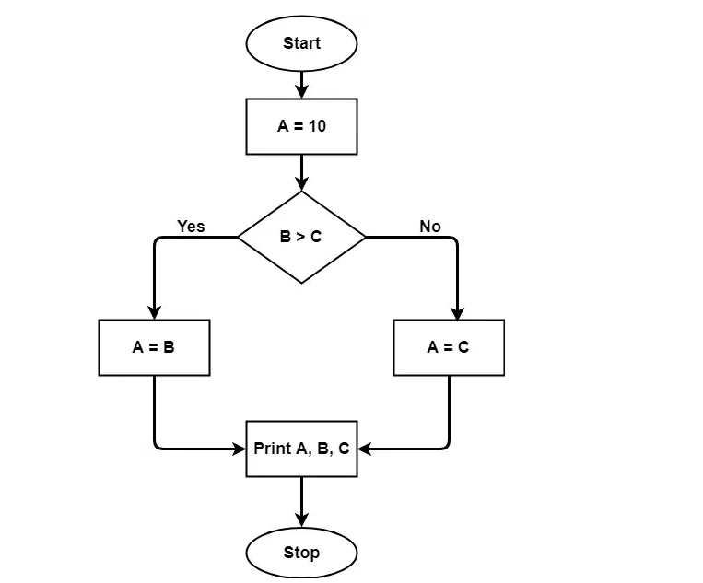

Slide 88
The cyclomatic complexity calculated for the above code will be from the control flow graph.
The graph shows
shapes(nodes) = 7
lines(edges) = 7
Exit component(P)= 1
M = E – N + 2P
hence cyclomatic complexity = 7-7+2 = 2.

Slide 89
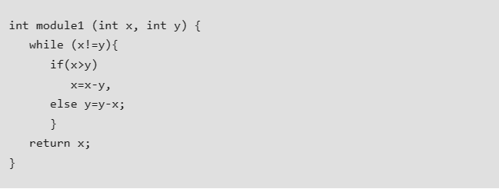
Cyclomatic Complexity = 3

Slide 90
Black -box Testing
The black-box testing is a testing technique where the test engineer selects a module and gives an input value to observe its functionality and analysis of whether the function is giving the expected output or not. If the function produced the correct output, then the particular function will be marked as pass.
To perform black-box testing, the test engineer should have specific knowledge about the software's requirement rather than programming knowledge of the software.
And then, they can develop the test cases to check the correctness of the software's functionality.
Black-box testing is further classified into two types, which are as follows:
Functional testing
Non-function testing
18

Slide 91
Black -box Testing
Generic steps of black box testing
The black box test is based on the specification of requirements, so it is examined in the beginning.
In the second step, the tester creates a positive test scenario and an adverse test scenario by selecting valid and invalid input values to check that the software is processing them correctly or incorrectly.
In the third step, the tester develops various test cases such as decision table, all pairs test, equivalent division, error estimation, cause-effect graph, etc.
The fourth phase includes the execution of all test cases.
In the fifth step, the tester compares the expected output against the actual output.
In the sixth and final step, if there is any flaw in the software, then it is cured and tested again.
18

Slide 92
Black -box Testing
Test procedure
The test procedure of black box testing is a kind of process in which the tester has specific knowledge about the software's work, and it develops test cases to check the accuracy of the software's functionality.
All test cases are designed by considering the input and output of a particular function.
Test cases
Test cases are created considering the specification of the requirements. These test cases are generally created from working descriptions of the software including requirements, design parameters, and other specifications.
They are mainly designed for functional testing but can also be used for non-functional testing. Test cases are designed by the testing team, there is not any involvement of the development team of software.

Slide 93

Black Box Testing
• Software considered as a black box:
–Test data derived from the specification
• No knowledge of code necessary
• Also known as:
– Data-driven or
– Input/output driven testing
• The goal is to achieve the thoroughness of exhaustive input testing:
–With much less effort!!!!
System
Input
Output

Slide 94
What is Hard about BB Testing
• Data domain is large
• A function may take multiple parameters:
– We need to consider the combinations of the values of the different parameters

Slide 95
Boundary Value Analysis
Boundary value analysis is one of the widely used case design technique for black box testing. It is used to test boundary values because the input values near the boundary have higher chances of error.
Boundary values are those that contain the upper and lower limit of a variable.
The basic assumption of boundary value analysis is, the test cases that are created using boundary values are most likely to cause an error.
Testing of boundary values is done by making valid and invalid partitions. Invalid partitions are tested because testing of output in adverse condition is also essential.
Ex: Imagine, there is a function that accepts a number between 18 to 30, where 18 is the minimum and 30 is the maximum value of valid partition

Slide 96
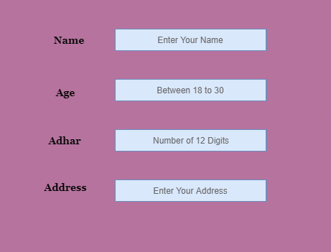
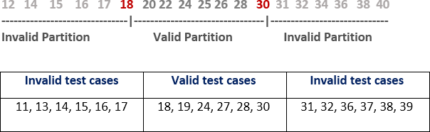

Slide 97
The software system will be passed in the test if it accepts a valid number and gives the desired output, if it is not, then it is unsuccessful.
In another scenario, the software system should not accept invalid numbers, and if the entered number is invalid, then it should display error massage.
If the software which is under test, follows all the testing guidelines and specifications then it is sent to the releasing team otherwise to the development team to fix the defects.

Slide 98
Boundary Value Analysis
• Example 1: Integer D with input range [-3, 10],
– test values: -3, 10, 11, -2, 0
• Example 2: Input in the range: [3,102]
– test values: 3, 102, -1, 200, 5

Slide 99
Equivalence Partitioning Method
Equivalence Partitioning Method is also known as Equivalence class partitioning (ECP). It is a software testing technique or black-box testing that divides input domain into classes of data, and with the help of these classes of data, test cases can be derived. An ideal test case identifies class of error that might require many arbitrary test cases to be executed before general error is observed.
Guidelines for Equivalence Partitioning :
If the range condition is given as an input, then one valid and two invalid equivalence classes are defined.
If a specific value is given as input, then one valid and two invalid equivalence classes are defined.
If a member of set is given as an input, then one valid and one invalid equivalence class is defined.
If Boolean no. is given as an input condition, then one valid and one invalid equivalence class is defined.

Slide 100
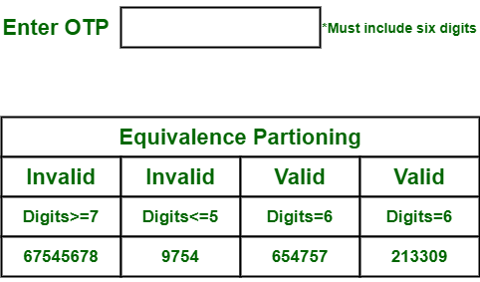
Equivalence Partitioning Method
Ex: There is function of software application that accepts only particular number of digits, not even greater or less than that particular number.
Consider an OTP number that contains only 6 digit number, greater and even less than six digits will not be accepted, and the application will redirect customer or user to error page.

Slide 101
Gray Box Testing
Gray Box Testing is a software testing technique that is a combination of the Black Box Testing technique and the White Box Testing technique.
In the Black Box Testing technique, the tester is unaware of the internal structure of the item being tested and in White Box Testing the internal structure is known to the tester.
The internal structure is partially known in Gray Box Testing.
This includes access to internal data structures and algorithms to design the test cases.
Gray Box Testing is named so because the software program is like a semitransparent or gray box inside which the tester can partially see.
It commonly focuses on context-specific errors related to web systems.

Slide 102
Gray Box Testing
Gray Box Testing
Objectives of Gray Box Testing
To provide combined advantages of both black box testing and white box testing.
To combine the input of developers as well as testers.
To improve overall product quality.
To reduce the overhead of long process of functional and non-functional testings.
To provide enough free time to developers to fix defects.
To test from the user point of view rather than a designer point of view.
Gray Box Testing Techniques-
Matrix Testing
Pattern Testing
Orthogonal Array Testing
Regression Testing
State transition Testing
Testing Decision Tables
Data Flow Testing

Slide 103
Gray Box Testing
Gray Box Testing
Advantages of Gray Box Testing
Increased Test Coverage: Gray box testing allows testers to design test cases based on both the specifications and the internal logic of the application.
Identifying Complex Defects: By having partial knowledge of the internal workings of the application, testers can identify and target complex defects that might not be apparent through purely black box testing. This includes issues related to integration between different modules or components, boundary conditions, and error handling mechanisms.
Efficient Testing: Gray box testing can be more efficient than white box testing since testers don't need to understand the entire codebase in detail. Instead, they focus on relevant portions of the code that are pertinent to the test scenarios, saving time and resources.
Early Detection of Defects: Gray box testing can facilitate early defect detection by enabling testers to identify potential issues during the development phase, even before the code is fully integrated or deployed. This allows for timely remediation and reduces the cost of fixing defects later in the development lifecycle.

Slide 104
Gray Box Testing
Disadvantages:
Limited Visibility: While gray box testing provides access to some internal code and structure, it may not provide a comprehensive understanding of the entire application. Testers may still miss defects or vulnerabilities that are hidden in parts of the code they don't have access to, leading to incomplete testing coverage.
Dependency on Implementation Details: Gray box testing relies on having access to certain implementation details of the application, which may change over time. If the internal structure or logic of the application evolves, existing gray box test cases may become obsolete or less effective, requiring frequent updates and maintenance.
Complexity: Gray box testing can introduce additional complexity, especially in large or complex applications. Testers need to strike a balance between understanding enough of the internal workings to design effective test cases and avoiding unnecessary overhead associated with trying to comprehend the entire codebase.
Skill Requirements: Effective gray box testing requires testers with a good understanding of both the application's specifications and its internal architecture. This can be challenging to achieve and may require specialized skills or training, making it potentially more resource-intensive compared to black box testing.

Slide 105
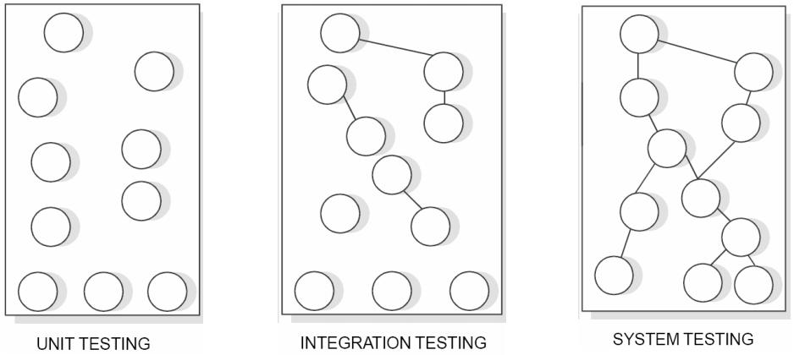
Level Of Testing
There are 3 levels of testing:
i. Unit Testing
ii. Integration Testing
iii. System Testing

Slide 106
Unit Testing (CO4)
It is also called module testing.
Follows a white box testing(logic of program).
Done by developer.
It is the testing of different units (or modules) of a system in isolation.
steps are needed in order to be able to test the module:
The procedures belonging to other modules that the module under test calls.
Nonlocal data structures that the module accesses.
A procedure to call the functions of the module under test with appropriate parameters.

Slide 107
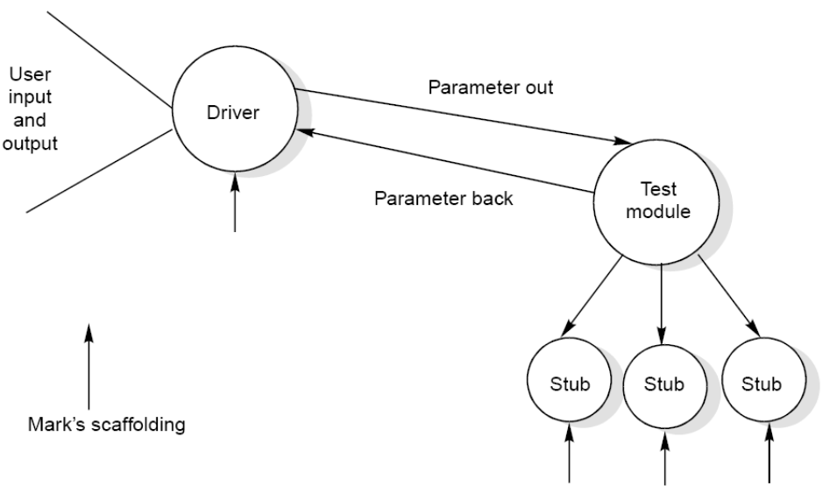
Stub and Driver
Stubs and drivers are designed to provide the complete environment
for a module.
Stub: it is a dummy procedure that has the same I/O parameters as the given procedure but has a highly simplified behavior.
Driver : it contain the nonlocal data structures accessed by the module under test, and would also have the code to call the different functions of the module with appropriate parameter values.

Slide 108
Integration Testing (CO4)
The purpose of unit testing is to determine that each independent module is correctly implemented. This gives little chance to determine that the interface between modules is also correct, and for this reason integration testing must be performed. One specific target of integration testing is the interface: whether parameters match on both sides as to type, permissible ranges, meaning and utilization.
Types of Integration Testing
Big – Bang Integration Testing
Top- down Integration Testing
Bottom up Integration Testing
Sandwich/Hybrid Integration Testing

Slide 109
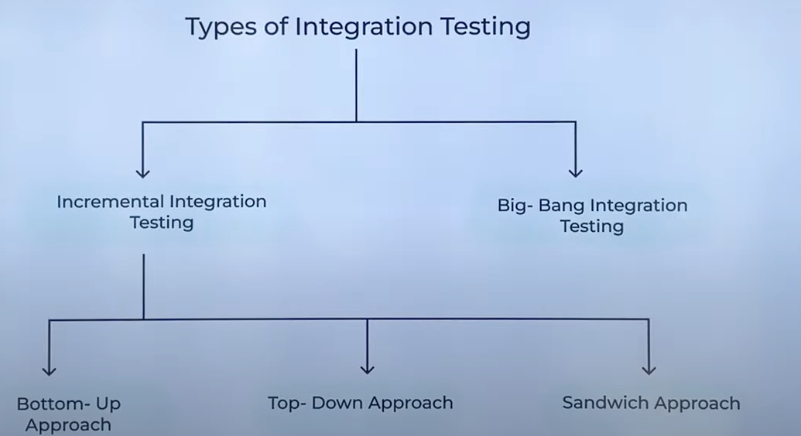

Slide 110
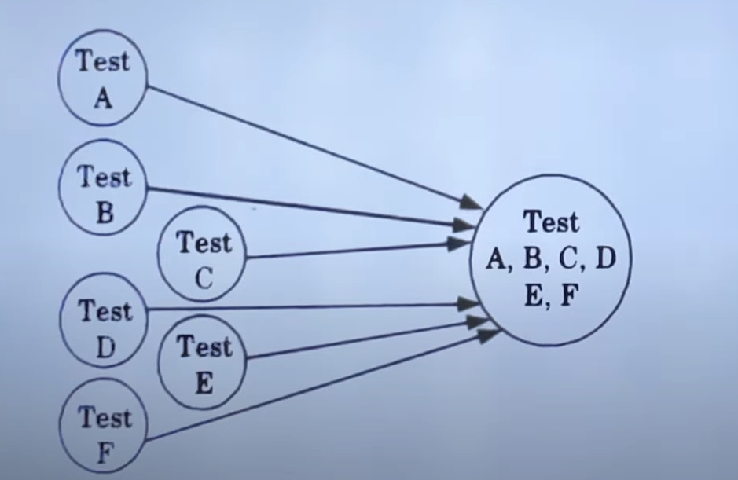
Types Integration Testing (CO4)
BIG – BANG TESTING : It is a type of integration testing that combines all the modules or components of a system into a single unit and tests them as a whole. It is a non incremental integration approach. Used in small and less complex softwares

Slide 111
Top-down Integration testing
Top-down incremental Integration testing builds the program structure by moving from the top module to the lower modules. The process follows a certain downward hierarchy where the lower-level (sub-modules) modules are integrated into the top-level module (main module) using either a depth-first or breadth-first method.
The primary advantage of this technique is to verify the control transfer and ease of integration as early as possible.
Almost all the Top-down models rely on Stubs (also called dummy programs) to run the testing. These stubs simulate the functioning of sub-modules.
Bottom-up Integration testing
Bottom-up Integration takes into account sub-modules and moves upward in the integration process. It eliminates the need for stubs, as lower-level modules are already available for integration before moving on to using the top module. It decreases the amount of overhead present in the Top-down approach. Drivers are used in Bottom-up Integration testing as opposed to stubs used in Top-down Integration testing.

Slide 112
Characteristic | Top-Down Integration Testing | Bottom-Up Integration Testing
Approach | Tests the highest-level modules first and then works down the hierarchy. | Tests the lowest-level modules first and then works up the order.
Stubs | It uses stubs to simulate the lower-level modules. | It uses drivers to simulate the higher-level modules.
Complexity | Less complex. | More complex.
Data Intensity | Less data intensive. | More data intensive.
Risk coverage | Focuses on identifying and mitigating risks early on. | Focuses on identifying and mitigating risks later in the testing process.
Scope | It can be used to test large and complex systems. | It is better suited for testing smaller and less complex systems.
Suitability | It is suitable for systems that have a clear hierarchical structure. | It is suitable for systems that need a clear hierarchical structure.
Benefits | It can help to identify and mitigate risks early on. | It can help to ensure that the lower-level modules are working as expected.
Drawbacks | It can be challenging to implement for large and complex systems. | It can be time-consuming and data-intensive to execute.
Examples | Operating systems, database systems, and word-processing software. | Device drivers, embedded systems, and microcontrollers.
Other Differences | Main module calls the sub modules Uses stubs as a replacement for missing sub modules Implemented on structured/procedure-oriented programming Significant to identify errors at the top levels Difficult to observe the output Simple to perform | Sub modules integrated with the top module(s) Makes use of drivers as a replacement for main/top modules Beneficial for object-oriented programming Good to determine defects at lower levels Easy to observe and record the results Highly complex and data-driven

Slide 113
Bottom-Up Integration
Only terminal modules is a strategy where the lower – level modules are tested first and then integrated and tested with the higher – level modules.
Modules at higher level are tested using the previously tested lower level modules
Non-terminal modules are not tested in isolation
Requires a module driver for each module to feed the test case input to the interface of the module being tested
However, stubs are not needed since we are starting with the terminal modules and use already tested modules when testing modules in the lower levels

Slide 114
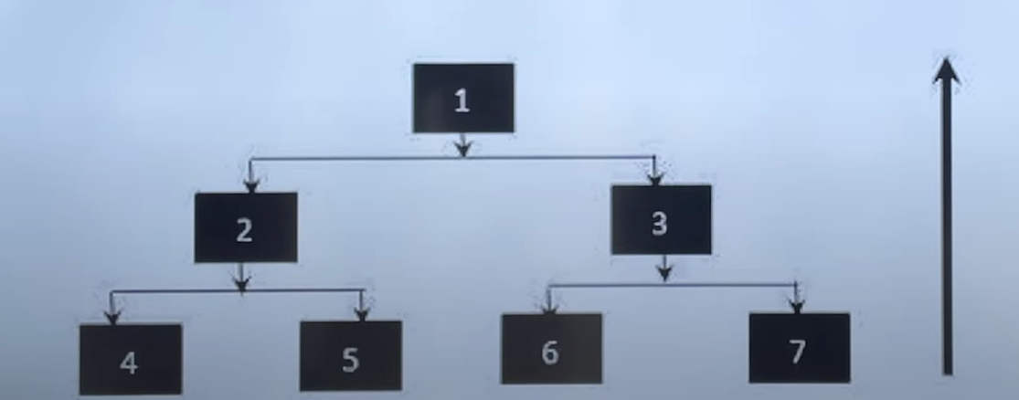
Bottom-Up Integration

Slide 115
Top-down Integration
Only modules tested in isolation are the modules which are at the highest level
After a module is tested, the modules directly called by that module are merged with the already tested module and the combination is tested
Requires stub modules to simulate the functions of the missing modules that may be called
However, drivers are not needed since we are starting with the modules which is not used by any other module and use already tested modules when testing modules in the higher levels

Slide 116
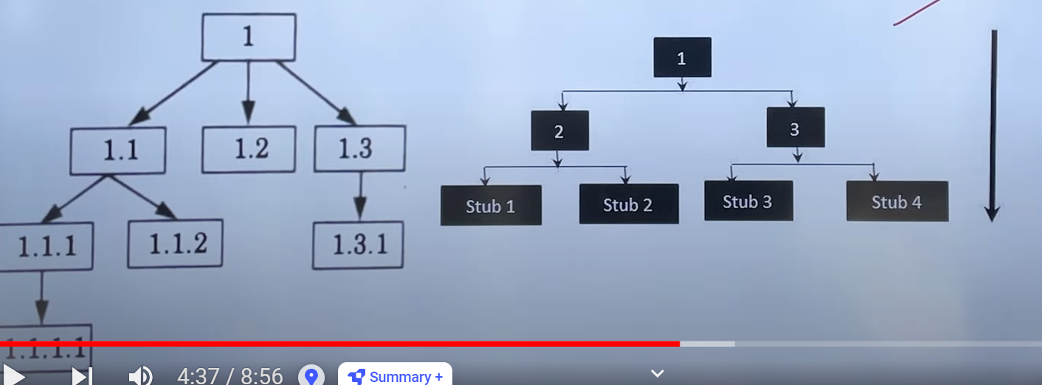
Top-down Integration

Slide 117
Other Integration Approaches
Sandwich Integration
Compromise between bottom-up and top-down testing
This system is viewed as a three layer just like a sandwich, the upper layer of sandwich use top down approach and lower layer of sandwich use bottom up approach.
Stubs and Drivers are used to rplace the missing modules in the middle.

Slide 118
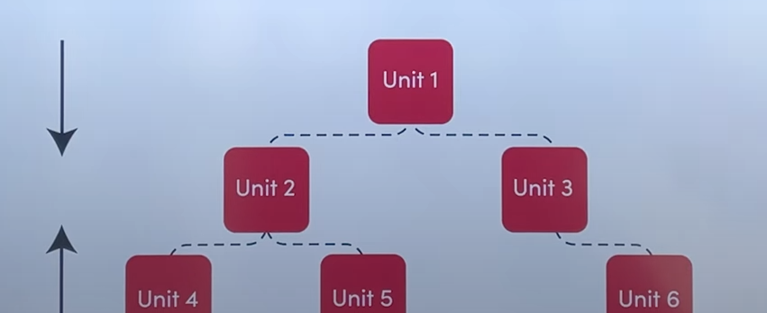
Sandwich Integration Approach

Slide 119
System Testing (CO4)
Alpha Testing: Alpha testing refers to the system testing carried out by the test team within the developing organization.
• Beta testing: Beta testing is the system testing performed by a select group of friendly customers.
• Acceptance Testing: Acceptance testing is the system testing performed by the customer to determine whether he should accept the delivery of the system.

Slide 120
System Testing
Performance testing : Performance testing is carried out to check whether the system needs the nonfunctional requirements identified in the SRS document. All performance tests can be considered as black-box tests.
• Stress testing
• Volume testing
• Configuration testing
• Compatibility testing
• Regression testing
• Recovery testing
• Maintenance testing
• Documentation testing
• Usability testing

Slide 121
System Testing
Stress testing : Stress tests are black box tests which are designed to impose a range of abnormal and even illegal input conditions so as to stress the capabilities of the software. For example, suppose an operating system is supposed to support 15 multi programmed jobs, the system is stressed by attempting to run 15 or more jobs simultaneously. A real-time system might be tested to determine the effect of simultaneous arrival of several high-priority interrupts.
• Volume testing: It is especially important to check whether the data structures (arrays, queues, stacks, etc.) have been designed to successfully extraordinary situations. For example, a compiler might be tested to check whether the symbol table overflows when a very large program is compiled

Slide 122
System Testing
• Configuration testing: This is used to analyze system behavior in various hardware and software configurations specified in the requirements.
• Compatibility testing : This type of testing is required when the system interfaces with other types of systems. Compatibility aims to check whether the interface functions perform as required.

Slide 123
System Testing
• Regression testing: This type of testing is required when the system being tested is an upgradation of an already existing system to fix some bugs or enhance functionality, performance, etc.
• Recovery testing : Recovery testing tests the response of the system to the presence of faults, or loss of power, devices, services, data, etc.
• Maintenance testing : This testing addresses the diagnostic programs, and other procedures that are required to be developed to help maintenance of the system. It is verified that the artifacts exist and they perform properly.

Slide 124
System Testing
• Documentation testing: It is checked that the required user manual, maintenance manuals, and technical manuals exist and are consistent.
• Usability testing: Usability testing concerns checking the user interface to see if it meets all user requirements concerning the user interface.

Slide 125
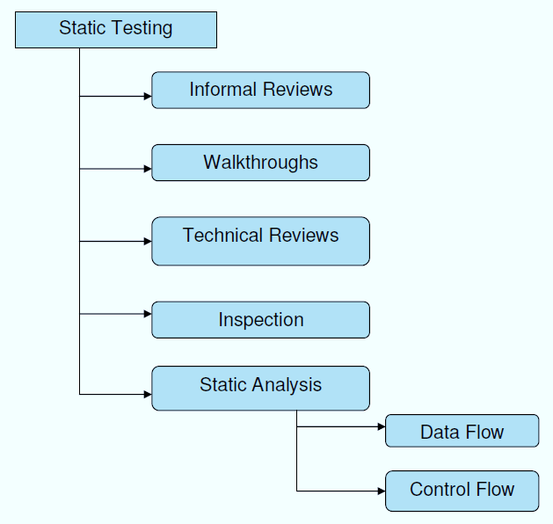
Static Testing Strategies:
Static Testing is a type of a Software Testing method which is performed to check the defects in software without actually executing the code of the software application. Whereas in Dynamic Testing checks the code is executed to detect the defects.
Static testing is performed in early stage of development to avoid errors as it is easier to find sources of failures and it can be fixed easily. The errors that can’t not be found using Dynamic Testing, can be easily found by Static Testing.

Slide 126
Review Process
It is a process or meeting conducted to find the potential defects in the design of any program. Another significance of review is that all the team members get to know about the progress of the project and sometimes the diversity of thoughts may result in excellent suggestions. Documents are directly examined by people and discrepancies are sorted out.
Reviews can further be classified into four parts:
Informal reviews
Walkthroughs
Technical review
Inspections

Slide 127
Review Process
During the Review process four types of participants that take part in testing are:
Moderator: Performs entry check, follow up on rework, coaching team member, schedule the meeting.
Author: Takes responsibility for fixing the defect found and improves the quality of the document
Scribe: It does the logging of the defect during a review and attends the review meeting
Reviewer: Check material for defects and inspects
Manager: Decide on the execution of reviews and ensures the review process objectives are met.
Types of defects that can be detected:
Deviations from standards
Non-maintainable code
Design defects
Missing requirements
Inconsistent interface specifications

Slide 128
Types of Review
Informal reviews take place between two or three people.
The review conference is scheduled at their convenience.
This meeting is generally scheduled during the free time of the team members.
There is no particular agenda and can be sometimes just a process of checking the progress done.
If any errors occur, they are not corrected in the informal reviews.
This review is less effective compared to the formal review.
Formal reviews take place among a team of three to five members.
In the formal review, the members discuss the software model.
They are all present with different knowledge and skillset.
This meeting is scheduled beforehand. This gives the team members time to prepare.
This meeting consists of a professional team that identifies and corrects errors in the model.
These kinds of reviews are not very often and are generally done twice or thrice during the entire cycle of the product.

Slide 129
Formal Technical Review(CO4)
Formal Technical Review(Code review)
Perform on module.
It is carried out after the module is successfully compiled and all the syntax errors have been eliminated.
It is extremely cost-effective strategies for reduction in coding errors and to produce high quality code.
Normally, two types of reviews are carried out on the code of a module.
1 Code inspection
2 Code walk Through

Slide 130
Code Walk Through (CO4)
The main objectives of the it is to discover the algorithmic and logical errors in the code.
It is an informal code analyses technique.
It is done after a module has been coded, successfully compiled and all syntax errors eliminated.
A few members of the development team are given the code few days before the walk through meeting to read and understand code.
Each member selects some test cases and simulates execution and tracing of the code by hand.
The members note down their findings to discuss these in a walk through meeting where the coder of the module is present.
After meeting several guidelines have evolved over the years for making this useful analysis technique more effective.

Slide 131
Code Walk Through
Some of these guidelines are the following.
The team performing code walk through should not be either too big or too small.
Discussion should focus on discovery of errors and not on how to fix the discovered errors.
In order to cooperation and to avoid the feeling among engineers that they are being evaluated in the code walk through meeting, managers should not attend the walk through meetings.

Slide 132
Code Inspection
Code inspections are more structured and formalized compared to walkthroughs.
In a code inspection, a designated team or group systematically reviews the code against a predefined checklist of criteria or standards.
Each reviewer individually examines the code, looking for deviations from coding standards, potential defects, performance issues, security vulnerabilities, and other concerns.
The emphasis is on thoroughness and accuracy, with reviewers following a predefined process to ensure consistency and effectiveness.
Code inspections typically involve documentation of findings and may require sign-off from all participants before the code is approved for further development or deployment.

Slide 133
Code inspection (CO4)
Code is examined for the presence of certain kinds of errors, in contrast to the hand simulation of code execution done in code walk through.
List of some classical programming errors which can be checked
during code inspection:
• Use of uninitialized variables.
• Jumps into loops.
• Non terminating loops.
• Incompatible assignments.
• Array indices out of bounds.
• Improper storage allocation and deallocation

Slide 134
Software Quality Assurance (SQA):
Software Quality Assurance (SQA) is simply a way to assure quality in the software. It is the set of activities which ensure processes, procedures as well as standards are suitable for the project and implemented correctly.
Software Quality Assurance is a process which works parallel to development of software. It focuses on improving the process of development of software so that problems can be prevented before they become a major issue. Software Quality Assurance is a kind of Umbrella activity that is applied throughout the software process.
Software Quality Assurance has:
A quality management approach
Formal technical reviews
Multi testing strategy
Effective software engineering technology
Measurement and reporting mechanism

Slide 135
SQA activities
Major Software Quality Assurance Activities:
SQA Management Plan: Make a plan for how you will carry out the sqa through out the project. Think about which set of software engineering activities are the best for project. check level of sqa team skills.
Set The Check Points: SQA team should set checkpoints. Evaluate the performance of the project on the basis of collected data on different check points.
Multi testing Strategy: Do not depend on a single testing approach. When you have a lot of testing approaches available use them.
Measure Change Impact: The changes for making the correction of an error sometimes re introduces more errors keep the measure of impact of change on project. Reset the new change to change check the compatibility of this fix with whole project.
Manage Good Relations: In the working environment managing good relations with other teams involved in the project development is mandatory. Bad relation of sqa team with programmers team will impact directly and badly on project. Don’t play politics.

Slide 136
CMM, The ISO standard.
ISO 9000: It is a set of International Standards on quality management and quality assurance developed to help companies effectively document the quality system elements needed to an efficient quality system.
Focus is customer supplier relationship, attempting to reduce customer’s risk in choosing a supplier. ISO9000 is recognized and accepted in most of the countries. This establishes one acceptance level.
SEICMM: SEI (Software Engineering Institute), Capability Maturity Model (CMM) specifies an increasing series of levels of a software development organization.
Focus on the software supplier to improve its interval processes to achieve a higher quality product for the benefit of the customer. SEICMM is used in USA, less widely elsewhere. It assesses on 5 levels.((a). Initial (b). Repeatable (c). Defined (d). Managed (e). Optimized )

Slide 137
Faculty Video Links, Youtube & NPTEL Video Links and Online Courses Details
https://nptel.ac.in/courses/106/105/106105182/
https://www.youtube.com/watch?v=mGrajqMLenI&list=PLyqSpQzTE6M-sBjDcT21Gpnj8grR2fDgc&index=16
https://www.youtube.com/watch?v=biKUffL8cm4&list=PLyqSpQzTE6M-sBjDcT21Gpnj8grR2fDgc&index=2
https://www.youtube.com/watch?v=0kkUnL1mdUY&list=PLyqSpQzTE6M-sBjDcT21Gpnj8grR2fDgc&index=4

Slide 138
Daily Quiz
1) Software testing is:
(a) The process of demonstrating that errors are not present
(b) The process of establishing confidence that a program does what it is supposed to do
(c) The process of executing a program to show it is working as per specifications
(d) The process of executing a program with the intent of finding errors
2) Software mistakes during coding are known as:
(a) failures (b) defects (c) bugs (d) errors
3) Functional testing is known as:
(a) Structural testing (b) Behavior testing (c) Regression testing (d) None
4) Regression testing is primarily related to:
(a) Functional testing (b) Data flow testing
(c) Development testing (d) Maintenance testing
5)Validation is
(a) Checking the product with respect to customer’s expectation
(b) Checking the product with respect to specifications
(c) Checking the product with respect to the constraints of the project
(d) All of the above

Slide 139
Daily Quiz
6) For a function of n variables, boundary value analysis yields:
(a) 4n+3 test cases (b) 4n+1 test cases
(c) n+4 test cases (d) None of the above
7 ) Beta testing is carried out by
(a) Users (b) Developers
(c) Testers (d) All of the above
8) Equivalence class partitioning is related to
(a) Structural testing (b) Black box testing
(c) Mutation testing (d) All of the above
9) Cause effect graphing techniques is one form of
(a) Maintenance testing (b) Structural testing
(c) Function testing (d) Regression testing
10) During validation
(a) Process is checked (b) Product is checked
(c) Developer’s performance is evaluated (d) The customer checks the product

Slide 140
Weekly Assignment
What is software testing? Discuss the role of software testing during software life cycle and why is it so difficult?
Why should we test? Who should do the testing?
What should we test? Comment importance of testing
Defined the following terms:
on this statement. Illustrate the
(i) fault | (ii) | failure
(iii) bug | (iv) | mistake
What is the difference between
Alpha testing & beta testing
Development & regression testing
Functional & structural testing
Discuss the limitation of testing. Why do we say that complete testing is impossible?

Slide 141
Weekly Assignment
7. Why does software fail after it has passed from acceptance testing? Explain
8. What are various kinds of functional testing? Describe any one in detail
9. Explain the boundary value analysis testing techniques with the help of an example
10. Discuss cause effect graphing technique with an example

Slide 142
MCQ
1 For a function of two variables, how many cases will be generated by robustness testing?
(a) 9
(c) 25
(b) 13
(d) 42
2 For a function of n variables robustness testing of boundary value analysis yields:
(a) 4n+1
(c) 6n+1
(b) 4n+3
(d) None of the above
3 Regression testing is primarily related to:
(a) Functional testing
(c) Development testing
(b) Data flow testing
(d) Maintenance testing
4 A node with indegree=0 and out degree ≠ 0 is called
(a) Source node
(c) Transfer node
(b) Destination node
(d) None of the above
5 A node with indegree ≠ 0 and out degree=0 is called
(a) Source node
(c) Destination node
(b) Predicate node
(d) None of the above

Slide 143
MCQ
6 A decision table has
(a) Four portions
(c) Five portions
(b) Three portions
(d) Two portions
7 Beta testing is carried out by
(a) Users
(c) Testers
(b) Developers
(d) All of the above
8 Equivalence class partitioning is related to
(a) Structural testing
(c) Mutation testing
(b) Blackbox testing
(d) All of the above
9 Cause effect graphing techniques is one form of
(a) Maintenance testing
(c) Function testing
10 During validation
(a) Process is checked
(c) Developer’s performance is evaluated
(b) Structural testing
(d) Regression testing
(b) Product is checked
(d) The customer checks the product

Slide 144
Glossary Questions
Formal testing with respect to user needs, requirements, and business processes conducted to determine whether or not a system satisfies the acceptance criteria and to enable the user, customers or other authorized entity to determine whether or not to accept the system. A step-by-step presentation by the author of a document in order to gather information and to establish a common understanding of its content. Testing where the system is subjected to large volumes of data. See also resource-utilization testing. Artifacts produced during the test process required to plan, design, and execute tests, such as documentation, scripts, inputs, expected results, set-up and clear-up procedures, files, databases, environment, and any additional software or utilities used in testing. A set of several test cases for a component or system under test, where the post condition of one test is often used as the precondition for the next one. | acceptance testing Walkthrough volume testing Testware test suite

Slide 145
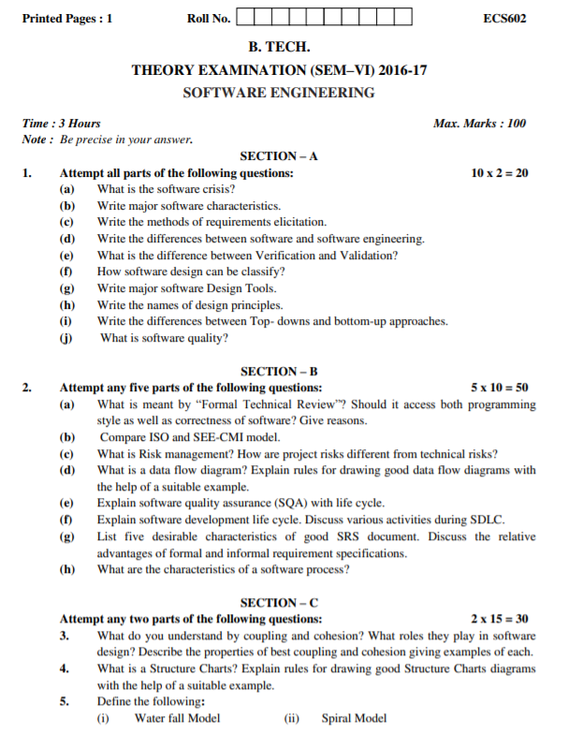
Old Question Papers

Slide 146
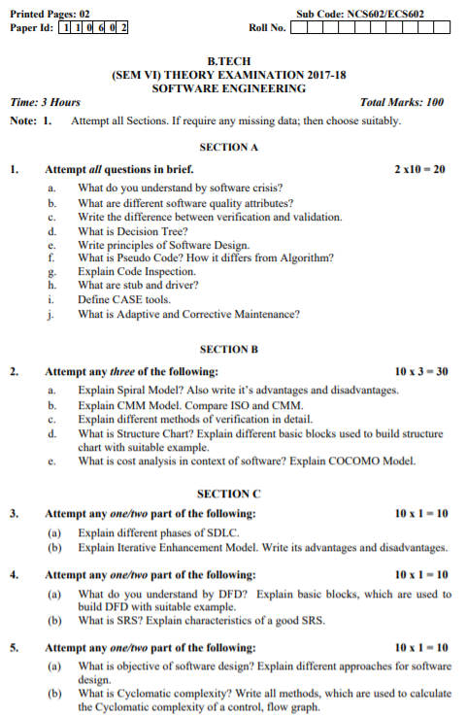
Old Question Papers

Slide 147
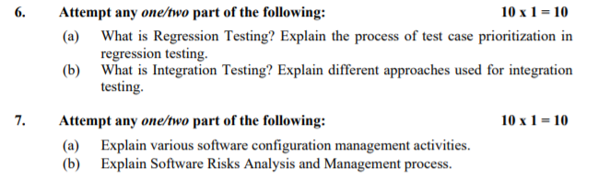
Old Question Papers

Slide 148
Expected Questions for University Exam
Why does software fail after it has passed from acceptance testing?
What are various kinds of functional testing? Describe any one in detail.
Explain the boundary value analysis testing techniques with the help of an example.
Describe the equivalence class testing method. Compare this with boundary value analysis techniques.
Discuss cause effect graphing technique with an example

Slide 149
Recap of Unit
Testing Objectives, UNIT Testing, Integration Testing, Acceptance Testing,
Regression Testing, Testing for functionality and Testing for Performance,
Top-Down and Bottom-Up Testing Strategies:
Test Drivers and Test Stubs,
Structural Testing (White Box Testing), Functional Testing (Black Box Testing),
Alpha and Beta Testing of Products.
Static Testing Strategies: Formal Technical Reviews (Peer Reviews), Walk Through,
Code Inspection, Compliance with Design and Coding Standards

Slide 150
References
R. S. Pressman, Software Engineering: A Practitioners Approach, McGraw Hill.
Rajib Mall, Fundamentals of Software Engineering, PHI Publication.
K. K. Aggarwal and Yogesh Singh, Software Engineering, New Age International Publishers.
Pankaj Jalote, Software Engineering, Wiley
Deepak Jain,” Software Engineering: Principles and Practices”, Oxford University Press.
Munesh C. Trivedi, Software Engineering, Khanna Publishing House
N.S. Gill, Software Engineering, Khanna Publishing House

Slide 151
Noida Institute of Engineering and Technology, Greater Noida
Thank You

